Slide 1

Design-based data-driven procedure for mapping forest resources:
A completely data-driven design-based strategy for mapping forest attributes within spatial units (e.g., pixels) partitioning the study area, also exploiting auxiliary sources of information.
Two main steps:
Google Earth Engine application for downloading auxiliary information
R-package for implementing the statistical procedure using the data downloaded with the GEE app
The user is guided from the preliminary choice of the assisting model to the final map and the estimation of its precision

Slide 2
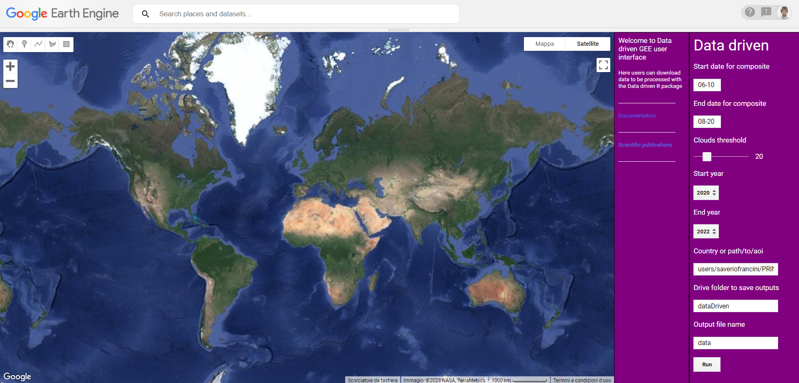
☑
GEE application for downloading remote sensing data globally
APP temporary link
https://code.earthengine.google.com/8ef06c5623fcac7eb21fe73a4b9448f0?hideCode=true

Slide 3
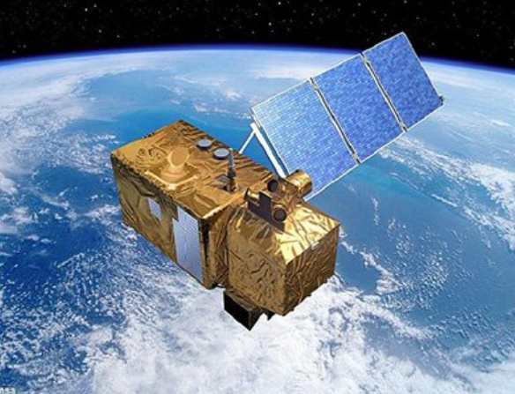
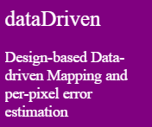
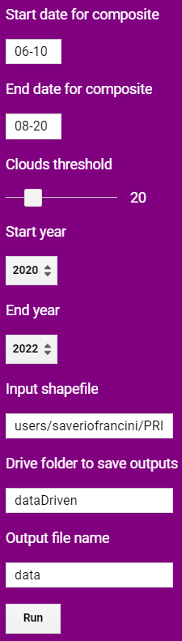
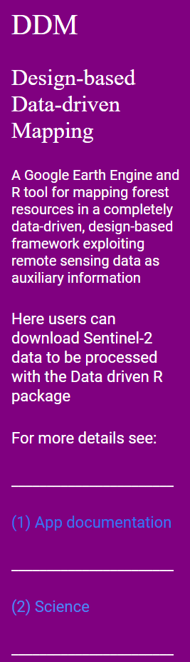
Define the period to select Sentinel-2 images yearly and construct pixel based medoid composides
Define the maximum percentage of clouds in the images to be included in the analysis
Define the years for which constructing Sentinel-2 medoid predictors
Define the study area
Define the name of the folder will be generated on your drive
Define the name of the file will be generated
Execute the app and get the predictors
Link to the documentation website and user manual. In progress.
Link to related scientific publications

Slide 4

R package implementing the statistical procedure
Steps:
Akaike-type criterion for model selection, removing the GEE variables poorly correlated with the interest variable
Least-squared method for predicting the values of the interest variable within the spatial units
Inverse distance weighting (IDW) interpolator for interpolating the residuals in non-sampled units, using the leave-one-out cross-validation for the selection of the smoothing parameter
Rescaling of the interest attribute to match traditional total estimates and map estimates
Bootstrap procedure for map uncertainty
☑
☑
☑
☑
Work in progress…

Slide 5

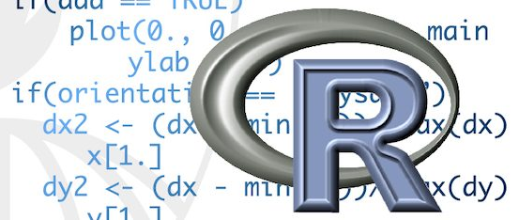
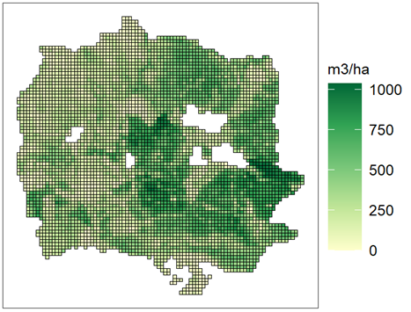
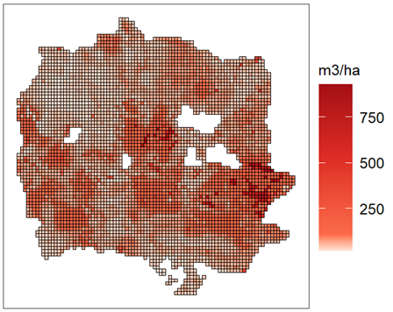
Final map and the estimation of its precision
Application to Rincine forest complex
Estimated wood volume map
Map of estimated errors

Slide 6
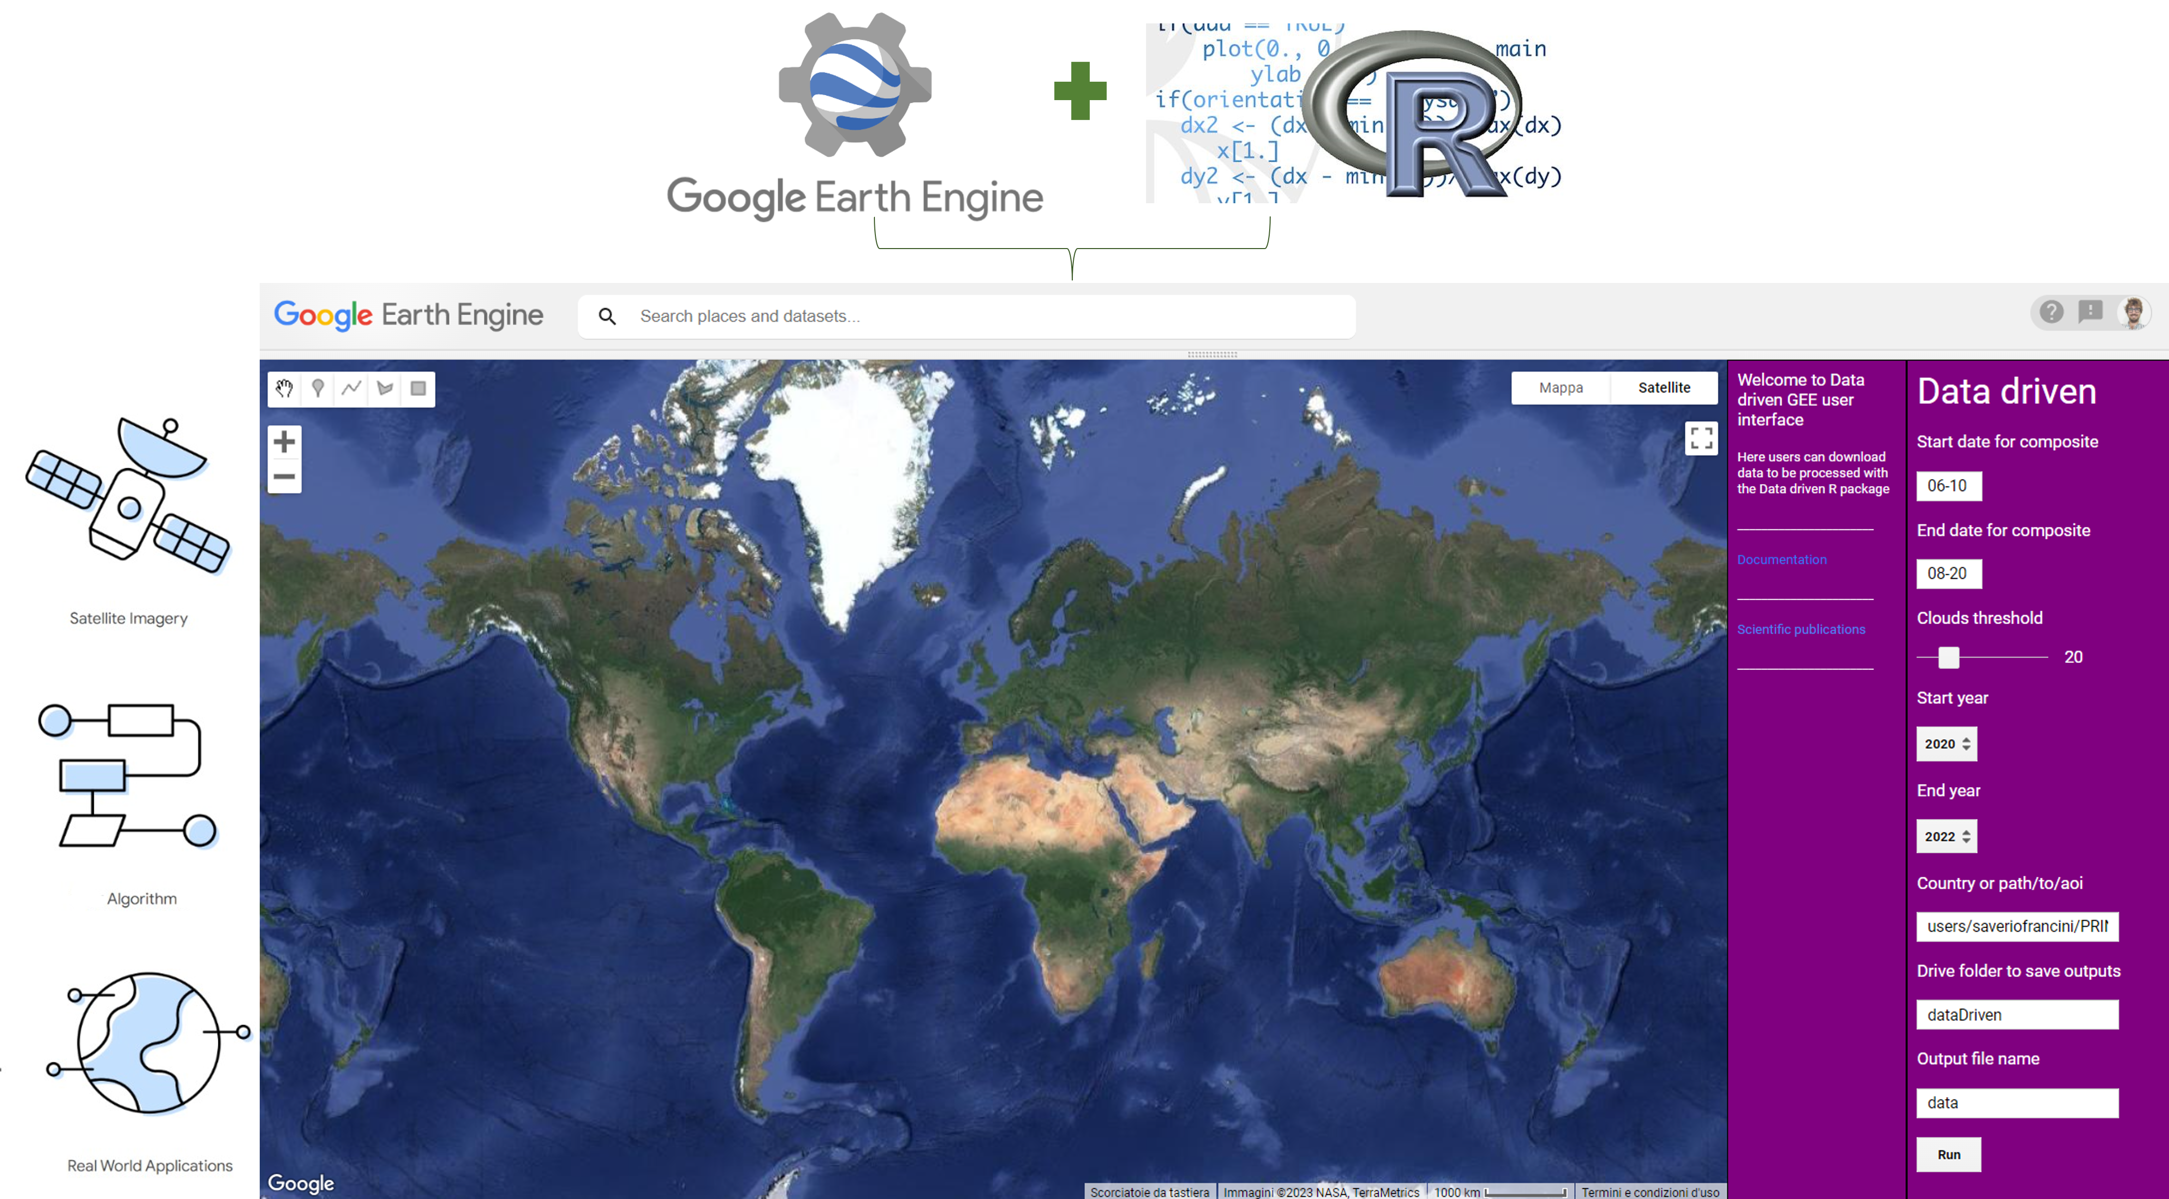
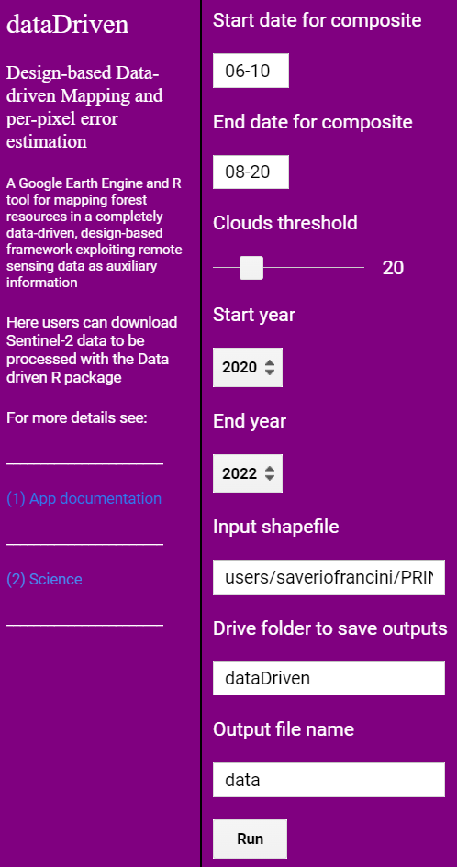
Predicted variable
Associated error

